Slide 1
Walmart In-Store Inventory Management System
Group 4:
Aishwarya G 001568096
Ashwath Balaji 002959297
Jashwanth Reddy 002988299
Shibo Lu 001548075
Simran Nagpurkar 002922747

Slide 2
Overview
A Database System designed to manage the overall functioning of Walmart - a retailer
This system will act as a centralized repository to manage inventory data (based on products, brand, category) and allows balancing inventory costs and risks against desired inventory performance metrics.
Provides insights about the operations associated with a store such as:
employee records
supplier information
transaction details
Allows for location based store-performance evaluation

Slide 3

Design
A system capable of
1. Maintaining an updated employee database to aid in operations analysis. For example:
To identify unstaffed departments
To identify departmental employee requirement during seasons or hours of peak demand
2. To track accurate supplier details for all brands and products (to maintain quality standards and manage back orders)
3. Analyze inventory and holding costs associated with a particular store
4. Calculate seasonal demand fluctuations for various products

Slide 4
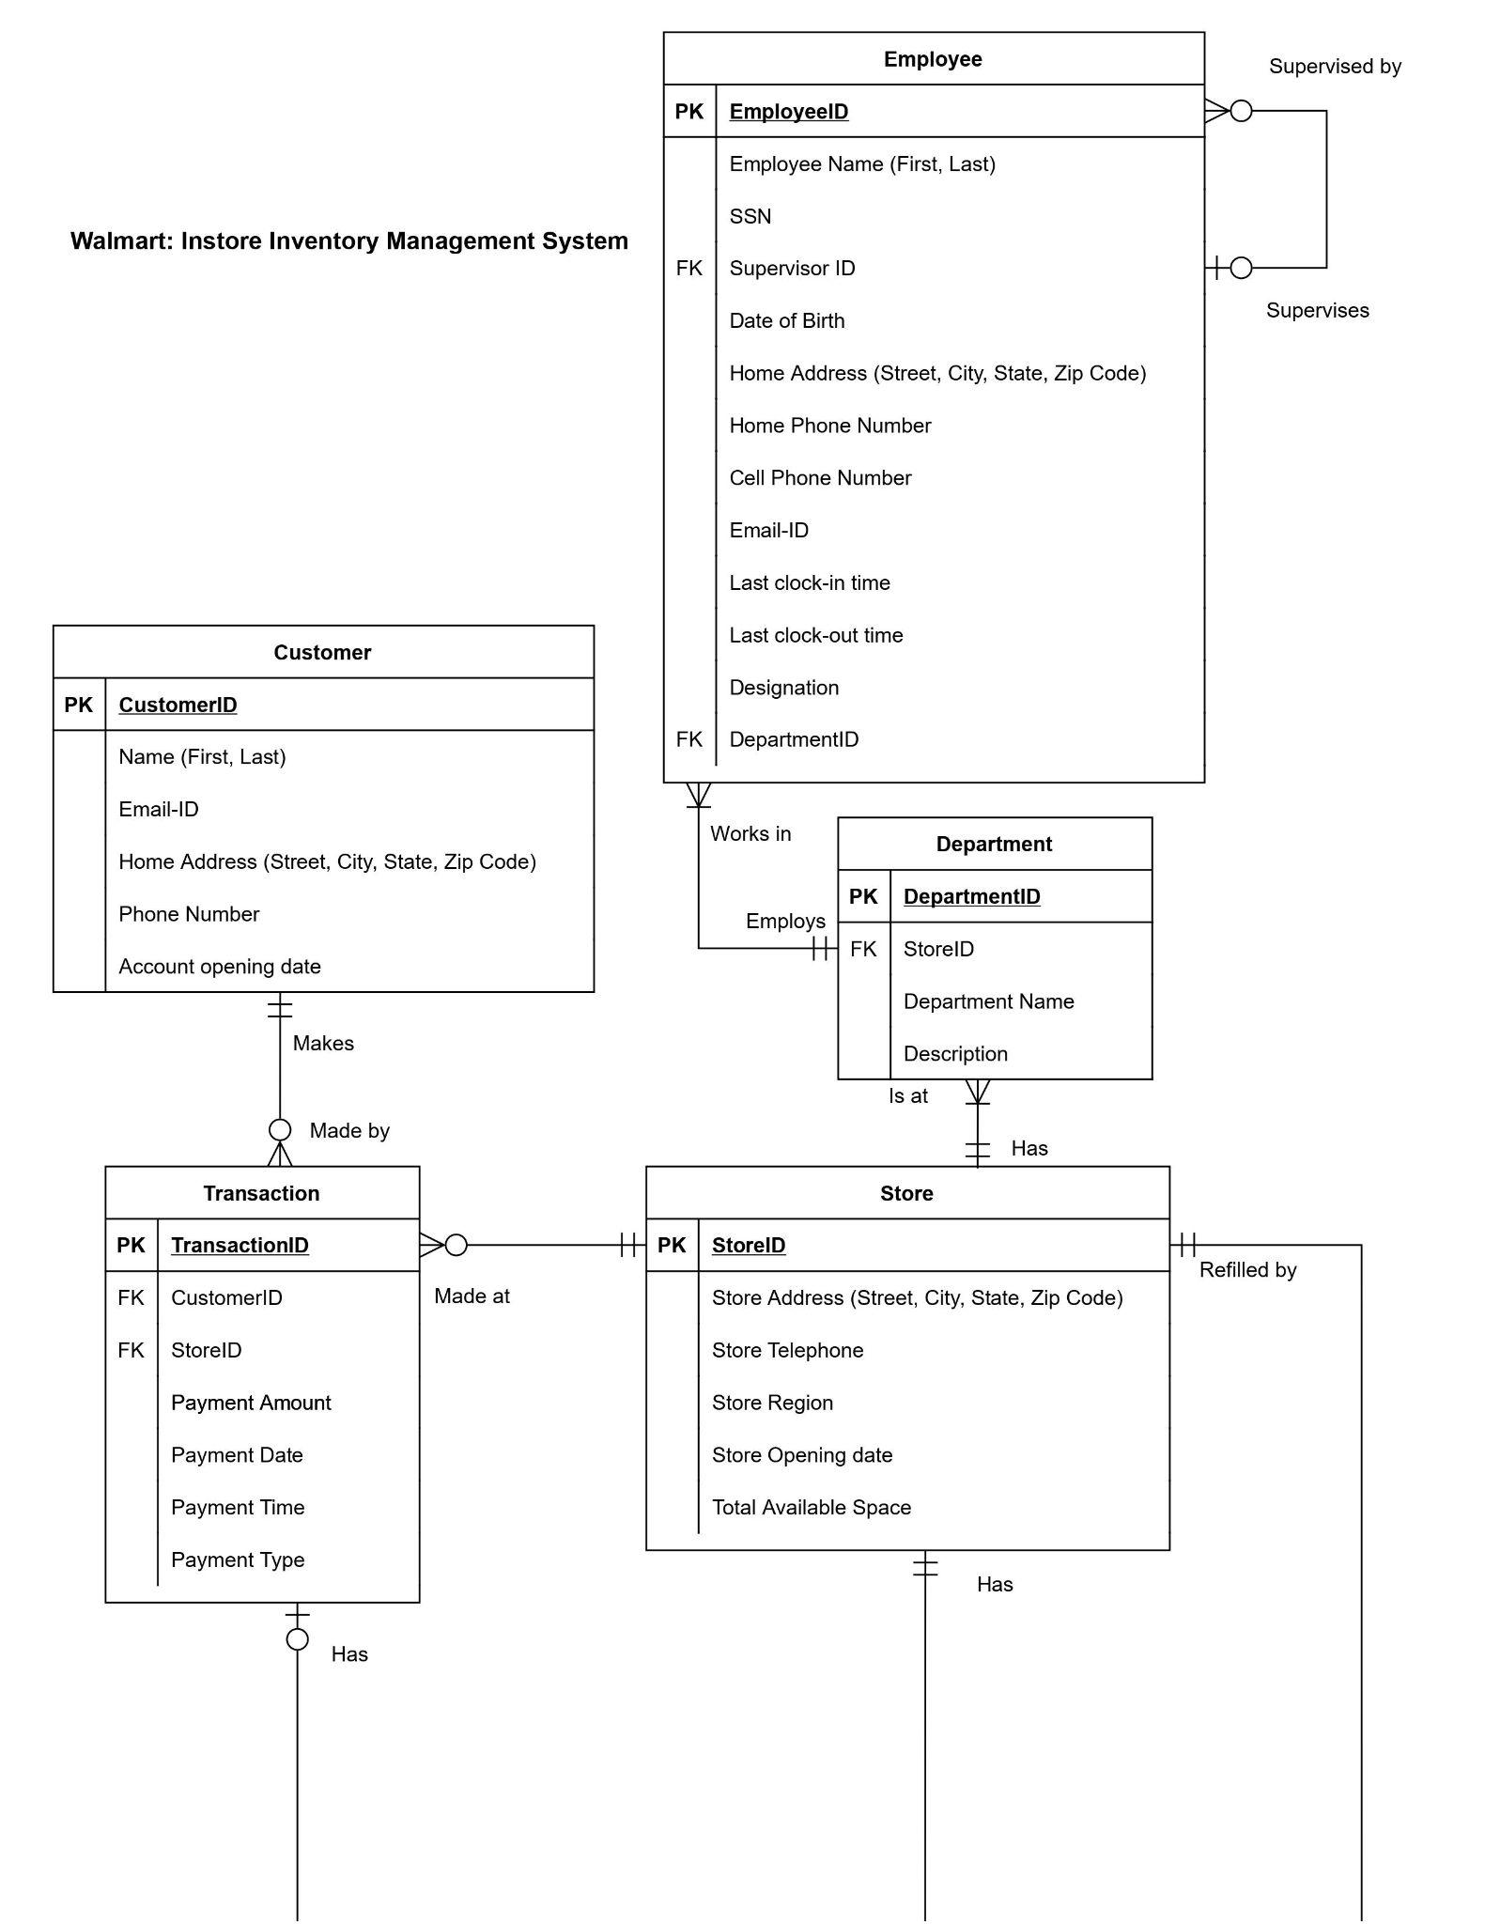
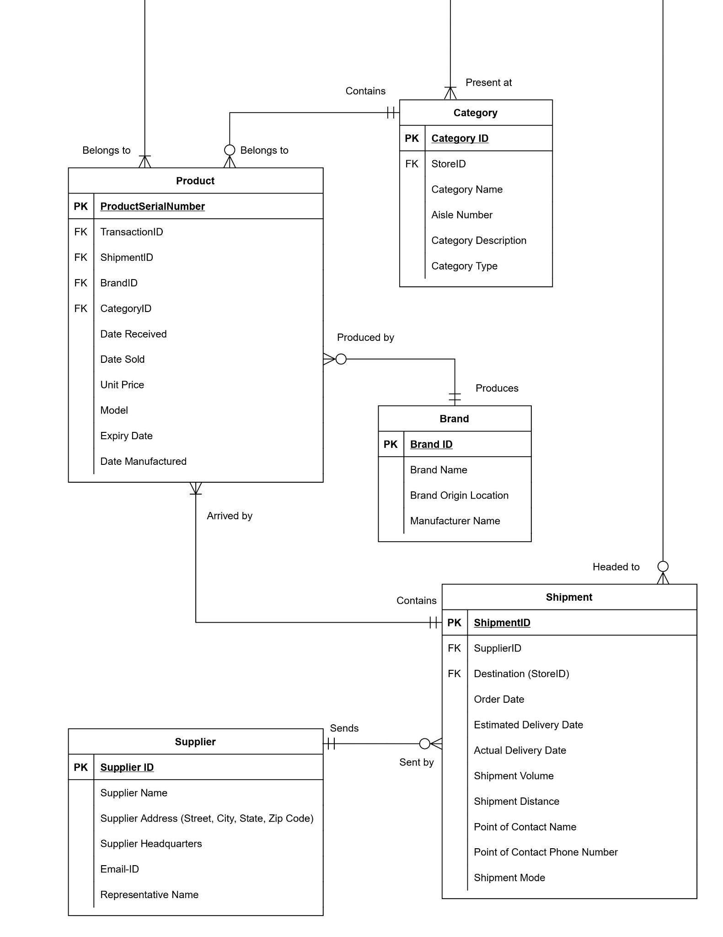
Entity-Relationship Diagram

Slide 5
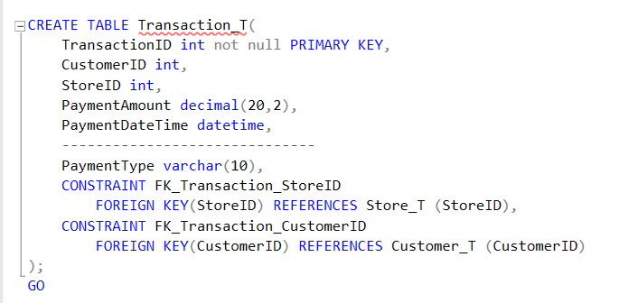
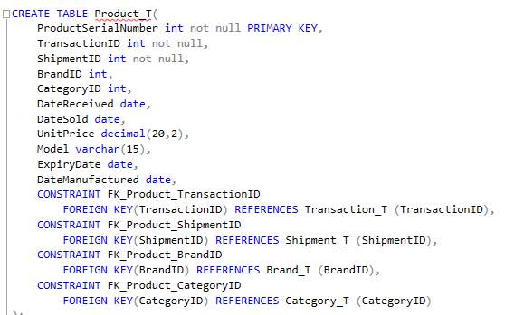
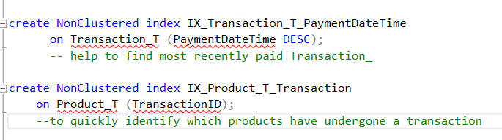
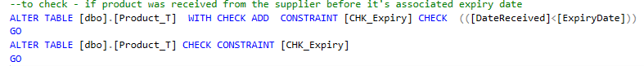
Database DDL
Transaction Table
Product Table
Check constraint
Non-clustered index is stored in a separate location from the data table.
A non-clustered index is like a book index, which is located separately from the main contents of the book.

Slide 6
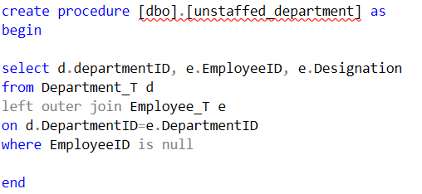
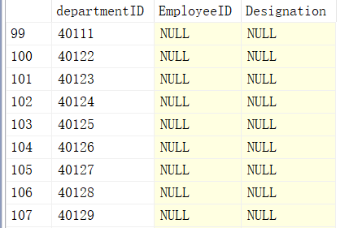
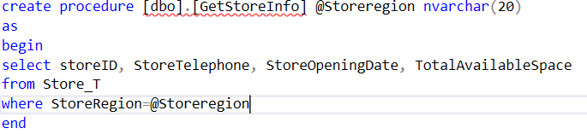
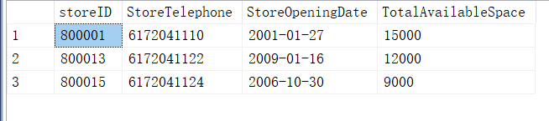
Stored Procedures

Slide 7
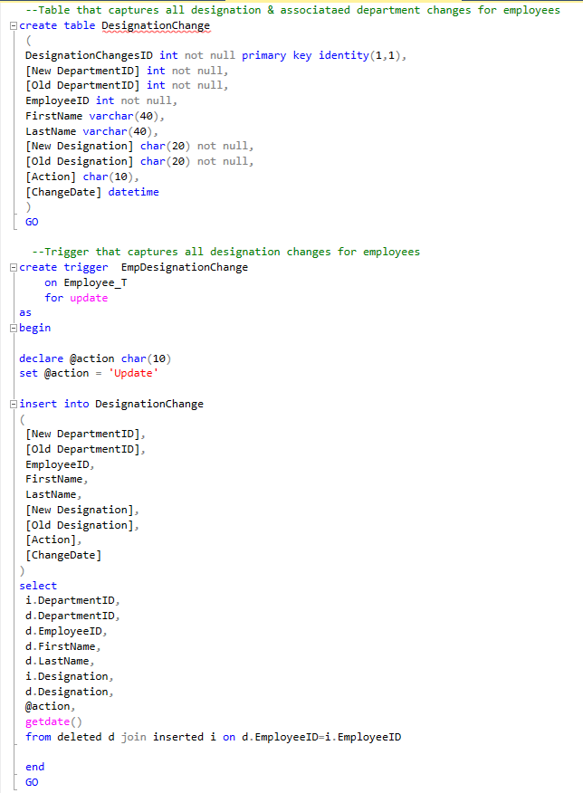
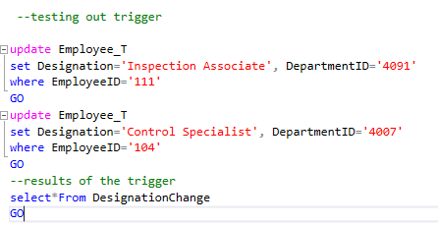
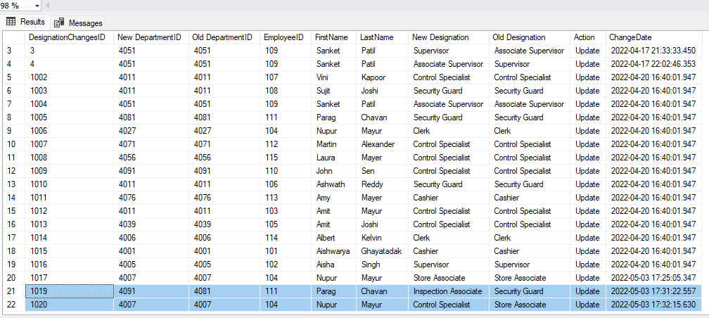
Triggers

Slide 8
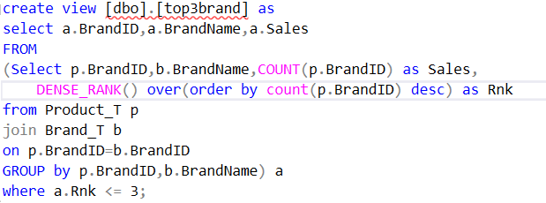
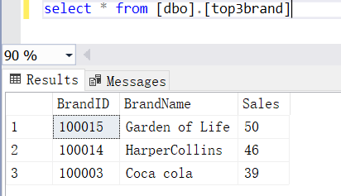
Views

Slide 9
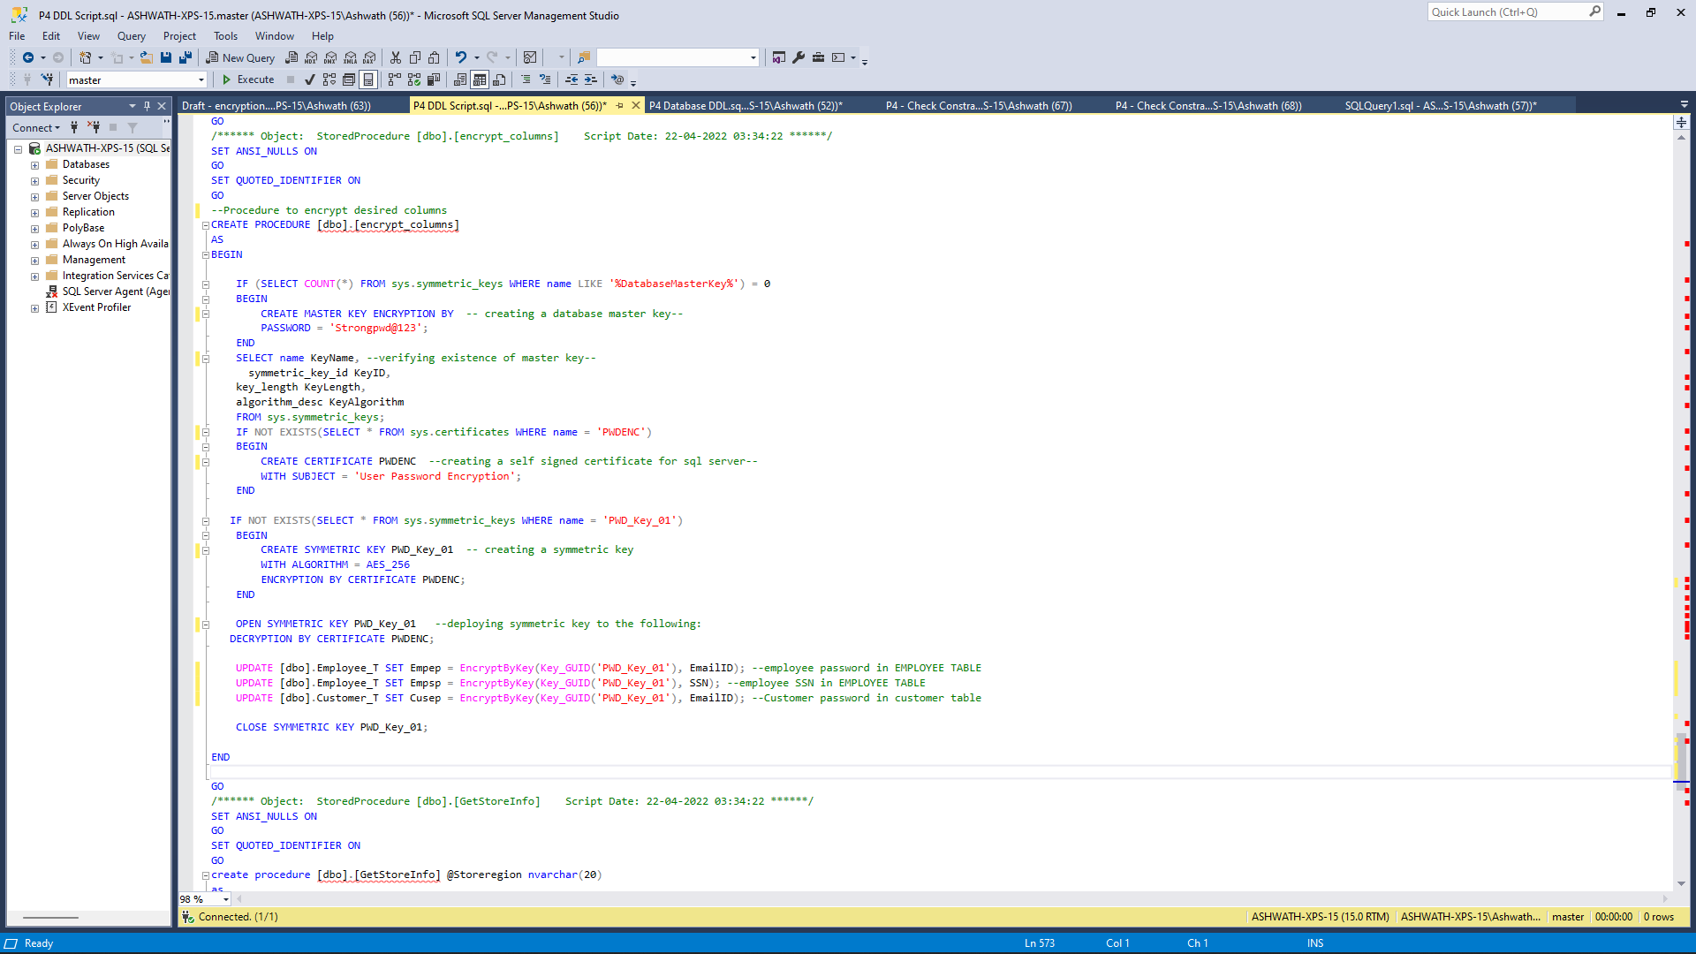
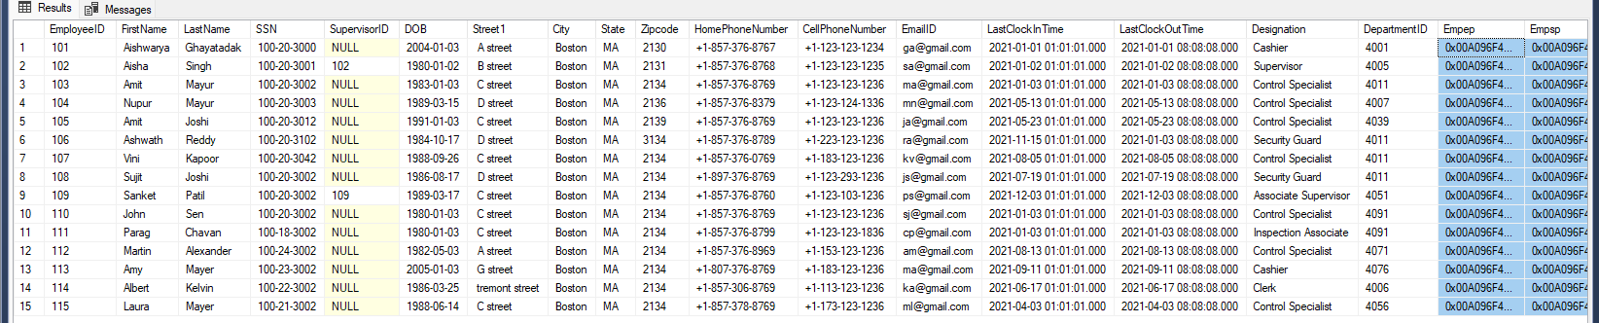
Column Data Encryption
Employee Table

Slide 10
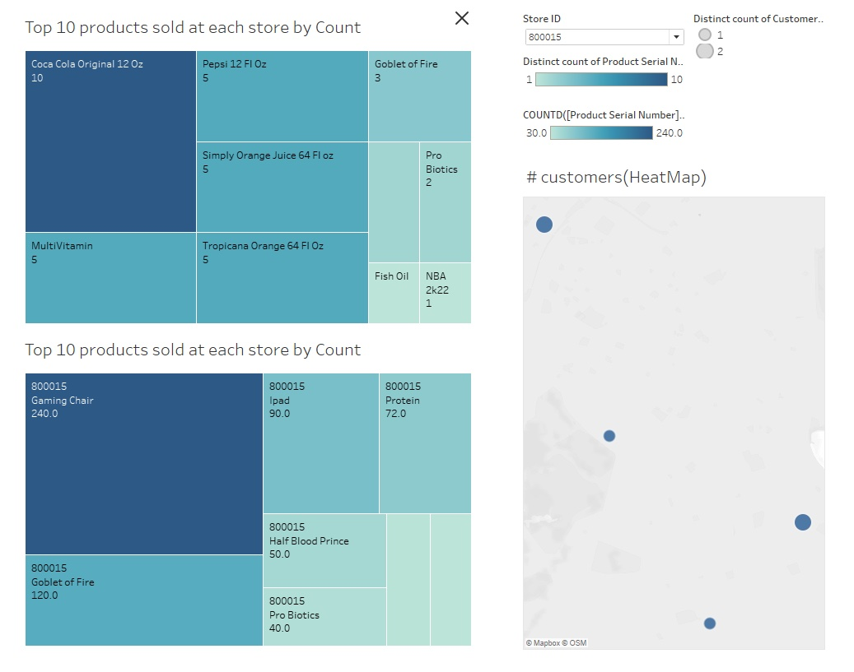
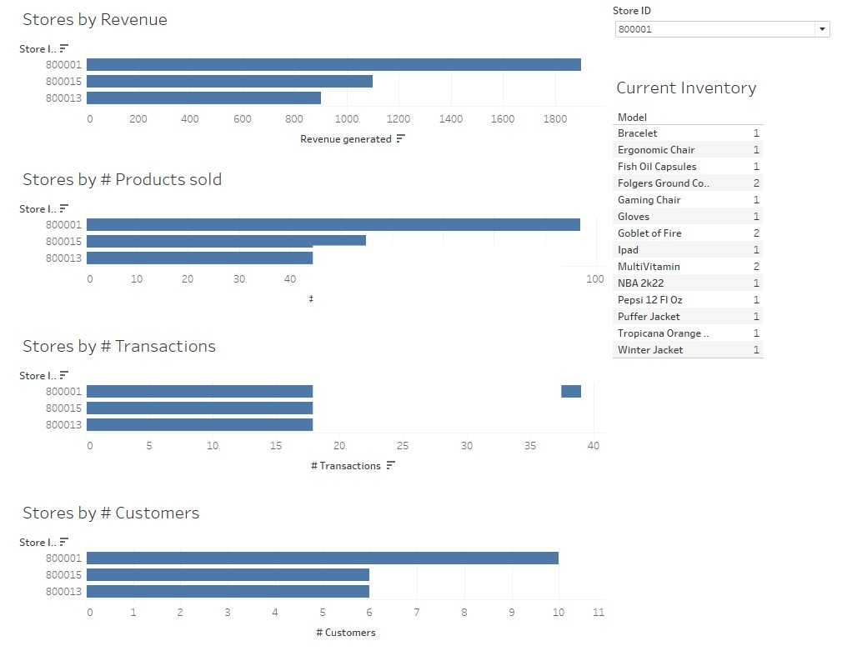
Tableau Dashboard
Insights from the Walmart Stores located in Boston
Revenue

